Slide 1

MauTransport Mobile Application
Team members:
Manasi D Chundunsing (M00843706),
Arusha Ramessur (M00940320),
Nageswararao Balloo (M00865938),
Jason J Bheekarry (M00909869),
Sneha Gunput (M00909869),
Kuba Sobczak (M00939847)
Date of Submission: 10/12/2024

Slide 2
Table of content
User requirements
Site Map
Wireflow
Story lines for main pages
10 heuristics principal integrated in our design
Expert evaluations
Video Prototype with additional principal in design
Inclusive design impairment simulator for vision and hearings
User testing

Slide 3
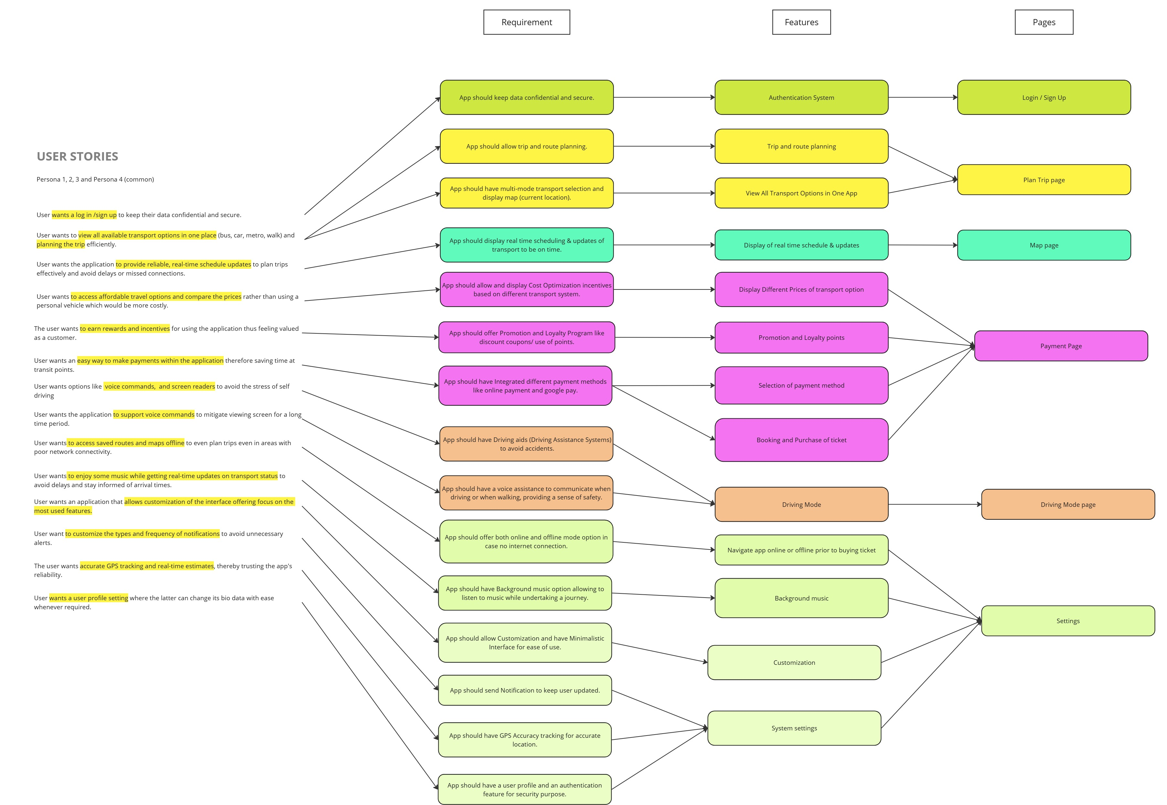
User Requirements
https://drive.google.com/file/d/1M2Xi68BsrH98uAiKN_yqtJiQTEtsVs8O/view?usp=sharing

Slide 4
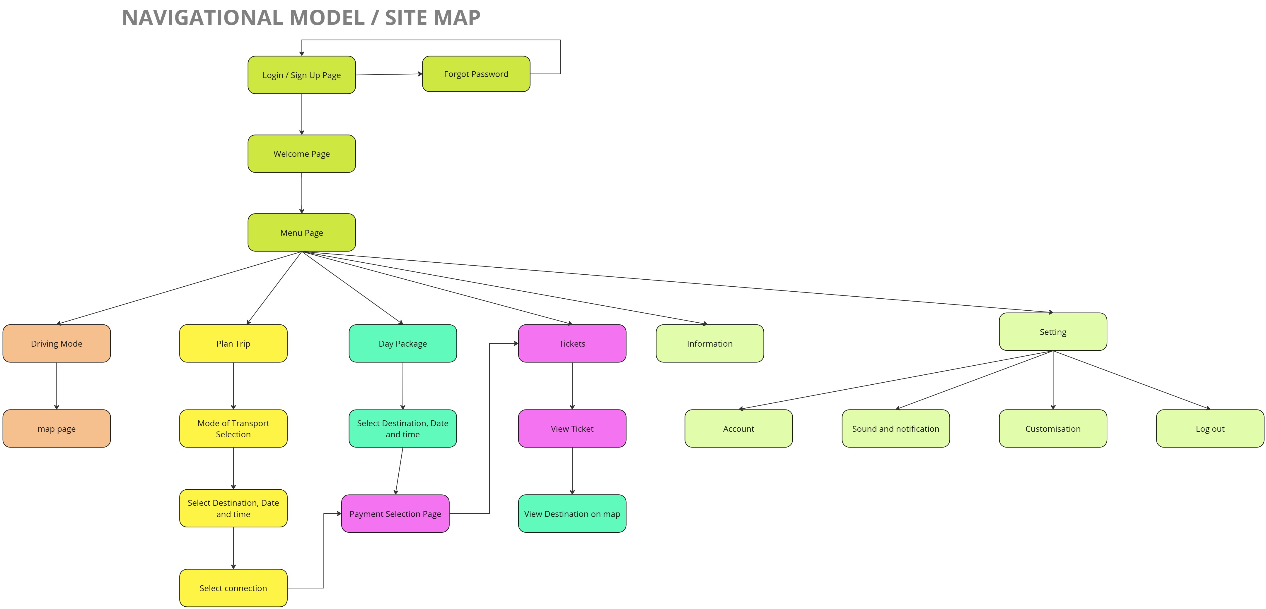
Navigational Model/Site Map
https://drive.google.com/file/d/1CrpYlj9qVW5B9wDwNtTfvpING9-YdD_o/view?usp=sharing

Slide 5
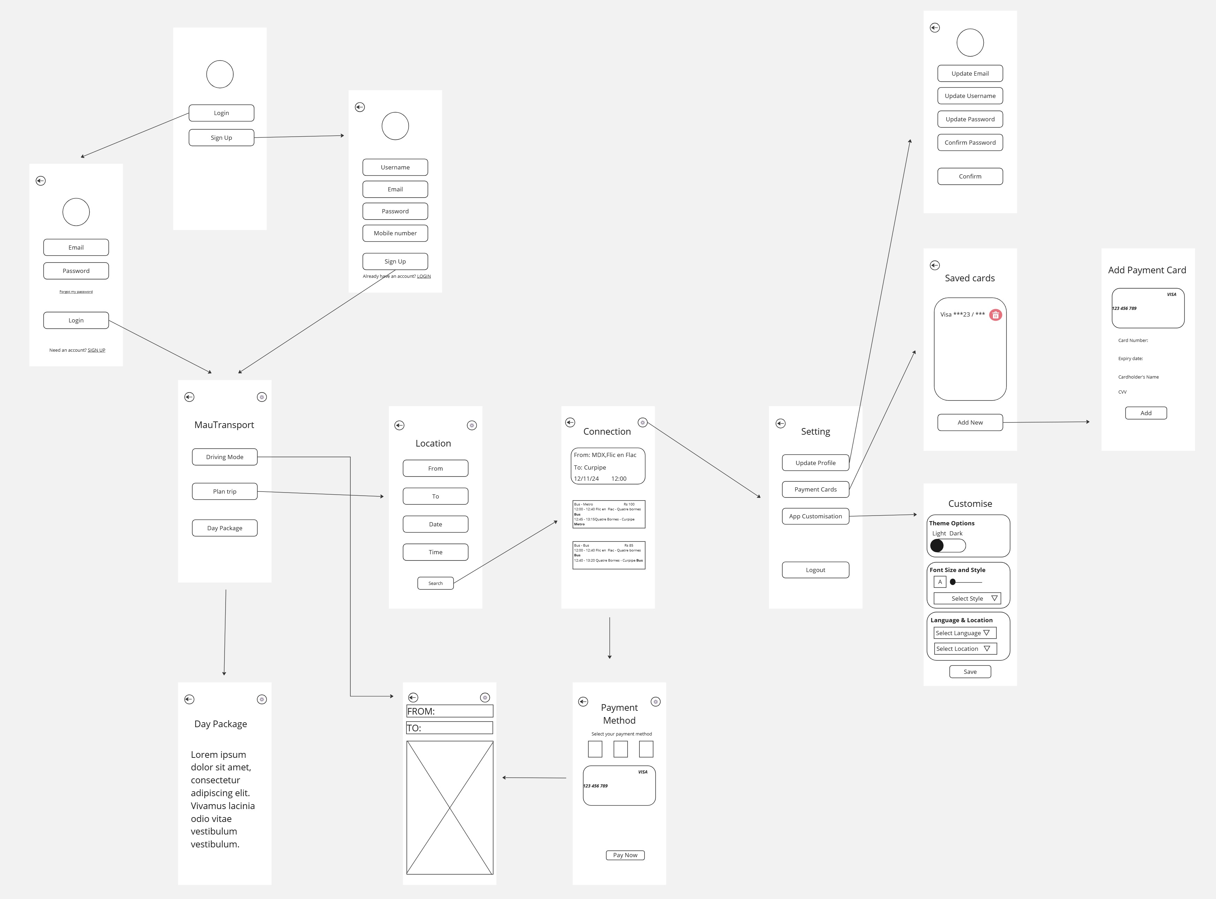
Wireflow
https://drive.google.com/file/d/1zAMpU5am7tmJvdIx4vV652TRzc1hrpra/view?usp=sharing

Slide 6
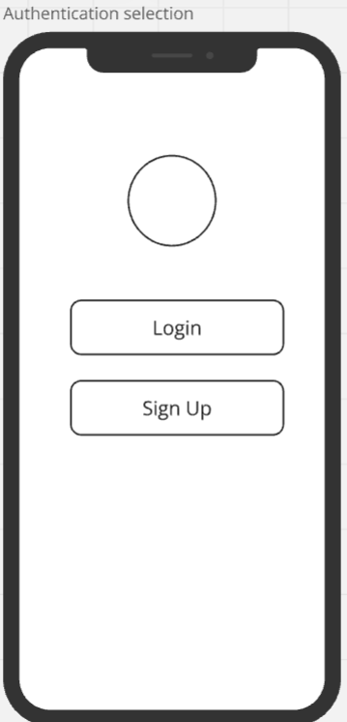
Story Line: Login/ registration
Main Goal: Provide a secure and simple way for users to create an account or log in.
Design Strategy:
Use minimal input fields for a quick process (email, password).
Highlight login and signup buttons with contrasting colors.
Page Storyline:
Welcome users with the MauTransport logo and tagline.
Provide "Login" and "Signup" buttons.

Slide 7
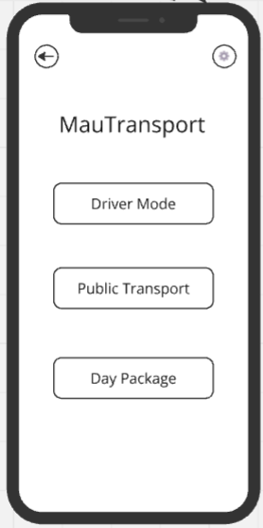
Story Line: Menu page
Main Goal: Provide centralized navigation to all key features of the app.
Design Strategy:
Use icons and descriptive labels for each feature (Driving Mode, Plan Trip, Day Package, etc.).
Page Storyline:
Display a clear menu header.
Offer clickable buttons/icons for each main feature.
Include a back arrow for easy navigation.

Slide 8
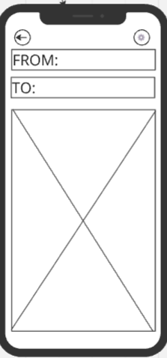
Story Line: Driving mode
Main Goal: Help users navigate their routes in real time.
Design Strategy:
Use a detailed, interactive map.
Include start and destination search fields.
Provide route duration and directions in real time.
Page Storyline:
Show the map with current location.
Allow users to input "From" and "To" fields.
Provide real-time route updates and estimated time.

Slide 9
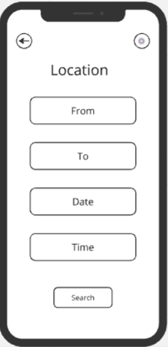
Story line: Plan Trip page
Main Goal: Allow users to plan and schedule their trips easily.
Design Strategy:
Include dropdowns for transport mode, location, date, and time selection.
Page Storyline:
Let users select starting and ending points.
Include date and time pickers.

Slide 10
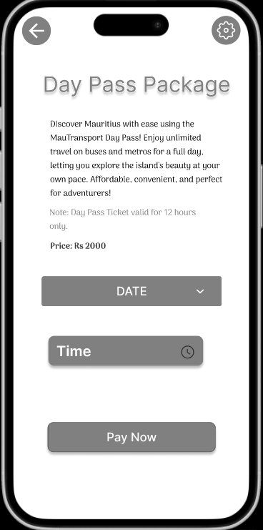
Story line: Day Package
Main Goal: Enable users to book full-day travel packages.
Design Strategy:
Highlight benefits of the day package with icons and brief descriptions.
Offer straightforward date and time selection.
Page Storyline:
Display a description of the day package benefits.
Allow users to select date and time.
Include a confirmation button leading to payment.

Slide 11
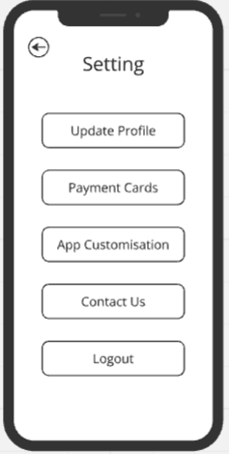
Story line: Setting Page
Main Goal: Allow users to manage their account, payment methods, and app preferences.
Design Strategy:
Organize settings into clear categories with labelled buttons.
Provide a back arrow for easy navigation.
Use minimalistic, accessible design with uniform button styling.
Page Storyline:
Include options for updating the profile, managing payment cards, customizing the app, contacting support, and logging out.
Place "Logout" at the bottom for logical flow.
Ensure the interface is simple and mobile-friendly.

Slide 12
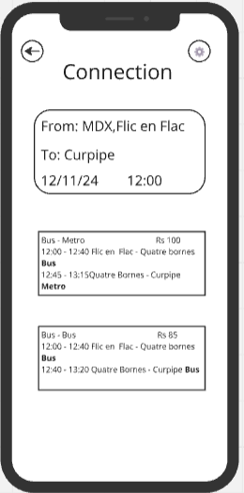
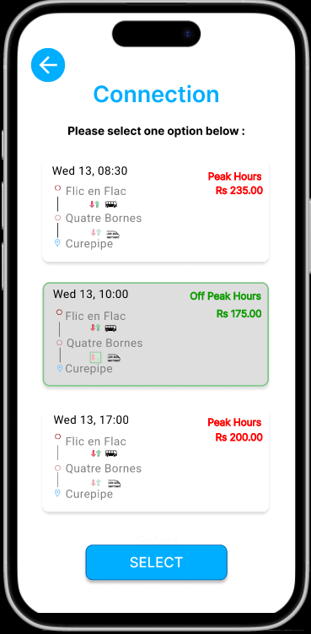
Improvement: Visibility of system status
We improved the system's visibility of status by highlighting the selected connection box, providing immediate feedback to confirm user actions. This ensures clarity, builds trust, and enhances the overall user experience.

Slide 13
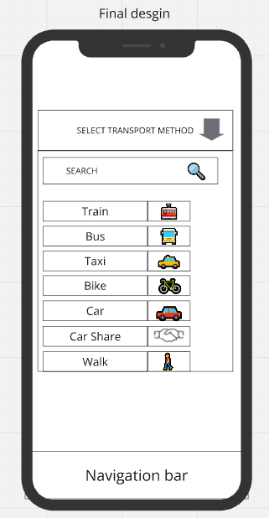
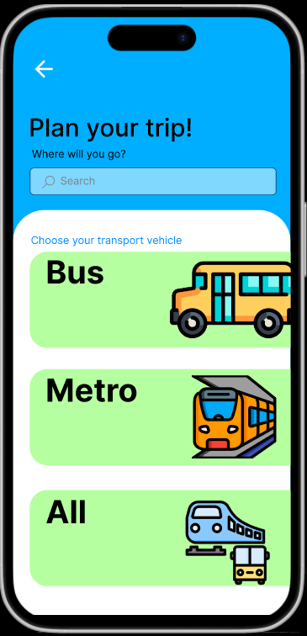
Improvement: Match between system and real-world
Use of Plain Language:
Simplified terms like "Bus" and "Metro" ensure users immediately recognize and understand the options.
Alignment with Real-World Conventions:
The design follows real-world mental models by displaying transport modes visually with familiar icons, making it intuitive for users.

Slide 14
Improvement: Match between system and real-world
Heuristic Principle: Visibility of System Status
Upon clicking a connection box, the interface now highlights the selected box, providing immediate feedback to the user that the system recognizes their choice.
Purpose:
To ensure users are informed that their action has been registered, improving trust in the system and reducing confusion.
Benefits:
Enhances usability by confirming user actions visually.
Aligns with the principle that a system should keep users informed about what is happening in real time.
Creates a smoother, more intuitive experience by reflecting the user's choice dynamically.
Skeuomorphism: Skeuomorphism is a term commonly used in graphical user interface design to describe interface items that mirror their real-world equivalents in how they appear and/or how the user may interact with them (IxDF, 2024)

Slide 15
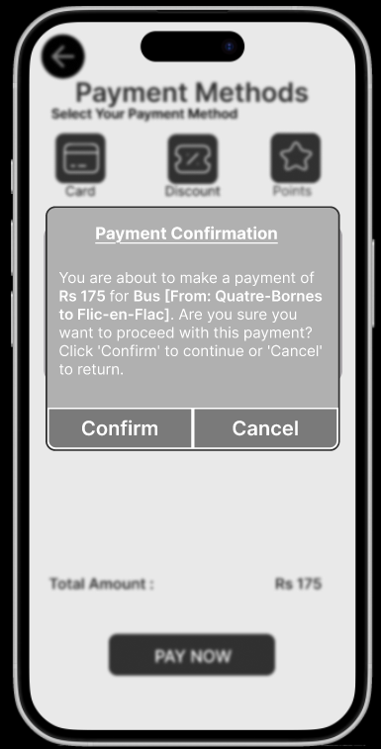
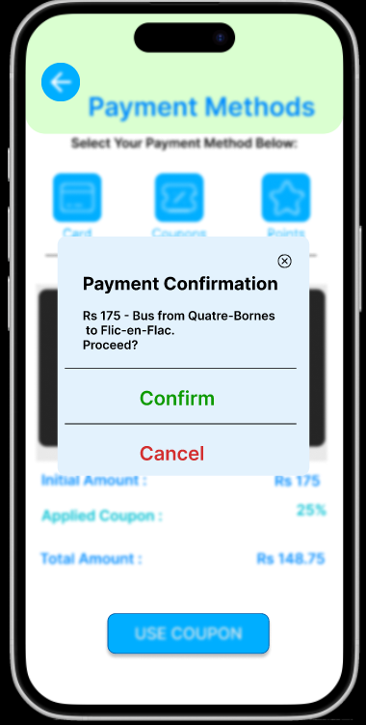
Improvement: User control and freedom
User Ability to Redo or Undo:
Added "Confirm" and "Cancel" options, ensuring users have full control to proceed or back out of an action, reducing errors and anxiety.
Use of Distinguishable Colors:
Green for Confirm and red for Cancel to visually guide users' attention and make the decision process intuitive.
Purpose:
Empower users to make deliberate choices while minimizing accidental actions.
Benefit:
Enhances usability by aligning with heuristic principles of user control and freedom and using clear visual cues to improve decision-making.

Slide 16
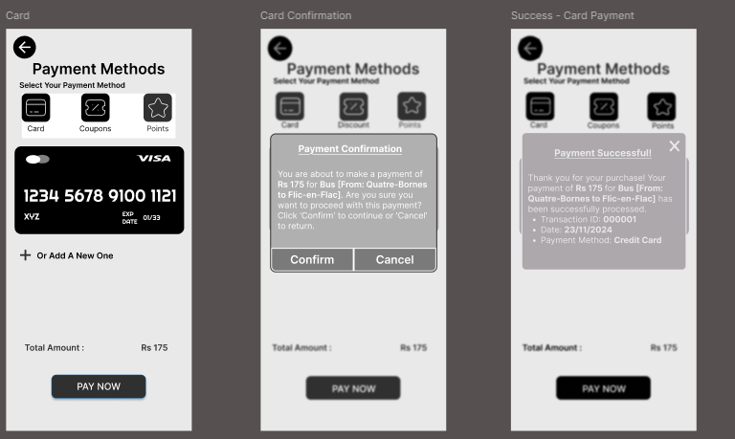
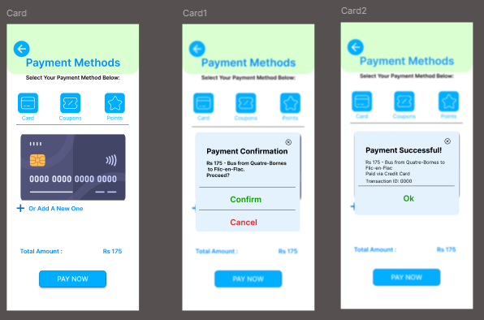
Improvement: Consistency and standards

Slide 17
Improvement: Consistency and Standards
Uniform Color Palette:
Applied the same colors across all screens to maintain visual harmony and brand identity.
Standardized Fonts:
Used the same font style and size throughout for readability and consistency.
Consistent Icons and Layouts:
Maintained the same icon styles and screen layouts across different stages (payment methods, confirmation, and success) for a cohesive user experience.
Purpose:
Align with the heuristic principle of consistency and standards, ensuring users feel comfortable and confident navigating through familiar design elements.
Benefit:
Reduces cognitive load and enhances usability by creating a seamless and professional interface.

Slide 18
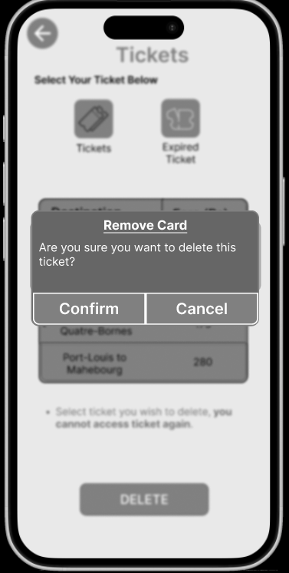
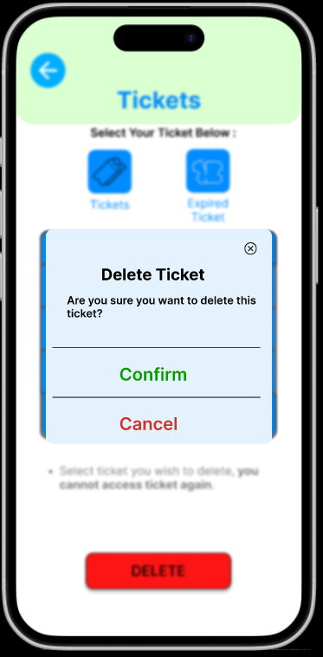
Improvement: error prevention
Added Confirmation Dialog:
A confirmation pop-up appears when users attempt to delete a ticket, asking, "Are you sure you want to delete this ticket?"
Purpose:
Prevents accidental deletion by requiring user verification before proceeding.
Use of Clear Visual Cues:
Green "Confirm" for proceeding and Red "Cancel" to stop the action, reducing user mistakes.
Benefit:
Aligns with error prevention principles, ensuring irreversible actions (like ticket deletion) are deliberate and avoiding potential user frustration.

Slide 19
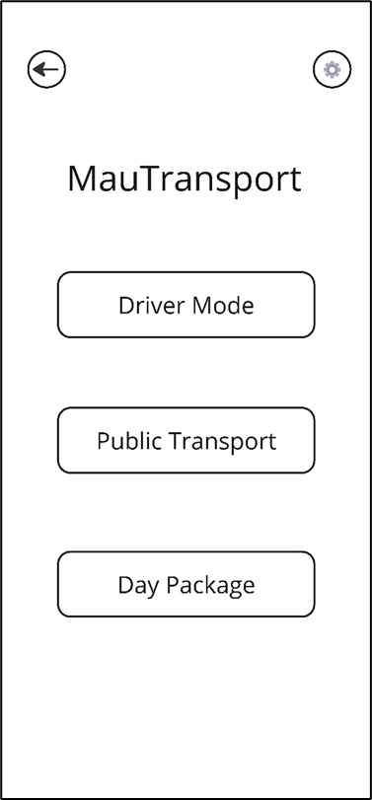
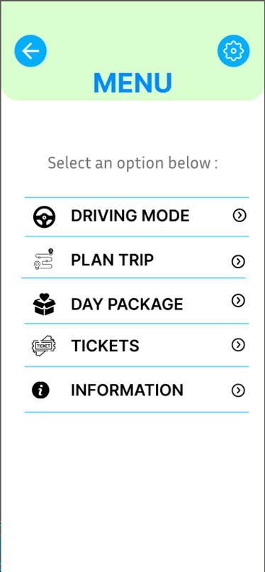
Improvement: recognition rather than recall
Enhanced Menu Labels:
Replaced ambiguous labels (e.g., "Driver Mode" and "Public Transport") with clear, descriptive options like "Driving Mode" and "Plan Trip" supported by icons.
Added Visual Cues:
Included universally recognizable icons next to each option to aid quick recognition and understanding.
Purpose:
Reduces cognitive load by presenting options in a way that users can instantly recognize, eliminating the need to remember what each option represents.
Benefit:
Improves usability and efficiency, ensuring users can quickly find and navigate to their desired action without confusion or hesitation

Slide 20
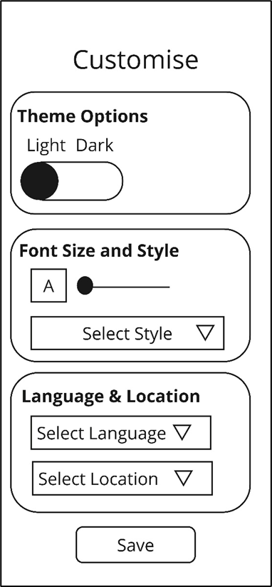
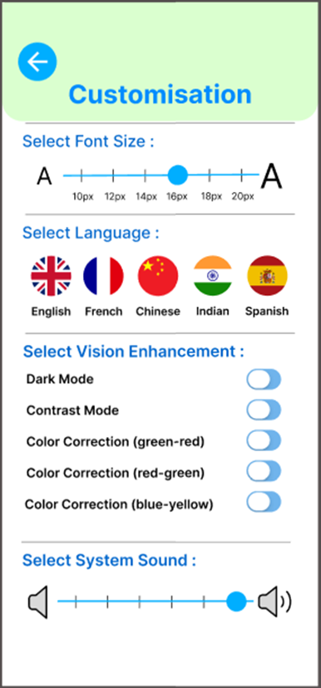
Improvement: flexibility and efficiency of use
Expanded Customization Options:
Added a broader range of features, such as font size adjustment, system sound controls, and vision enhancement options (e.g., dark mode, color correction).
Language Flexibility:
Included multiple language options with flags for intuitive selection, catering to diverse user needs.
Enhanced Accessibility:
Introduced vision enhancement tools for color correction (green-red, red-green, blue-yellow) and contrast adjustments to support users with visual impairments.
Purpose:
Allows users to tailor the interface to their preferences and needs, ensuring inclusivity and a personalized experience.
Benefit:
Improves usability for a diverse range of users while maximizing efficiency and comfort in interacting with the app.

Slide 21
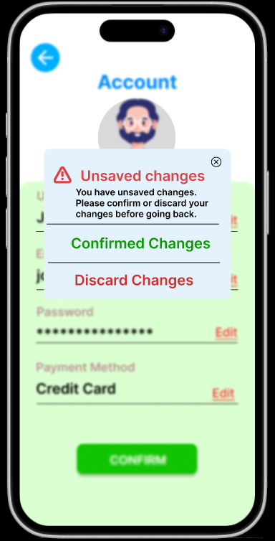
Improvement: Help users recognize, diagnose and recover from errors
Error Recognition:
Added a clear "Unsaved Changes" warning pop-up with a red alert icon to catch the user's attention.
Error Diagnosis:
The message explicitly informs users: "You have unsaved changes. Please confirm or discard your changes before going back," helping them understand the issue.
Error Recovery:
Provides two actionable buttons:
"Confirm Changes" (saves changes and proceeds).
"Discard Changes" (proceeds without saving).
Purpose:
Ensures users don’t accidentally lose progress, guiding them to handle errors effectively.
Benefit:
Reduces frustration by offering clear instructions and empowering users to recover from potential mistakes.

Slide 22
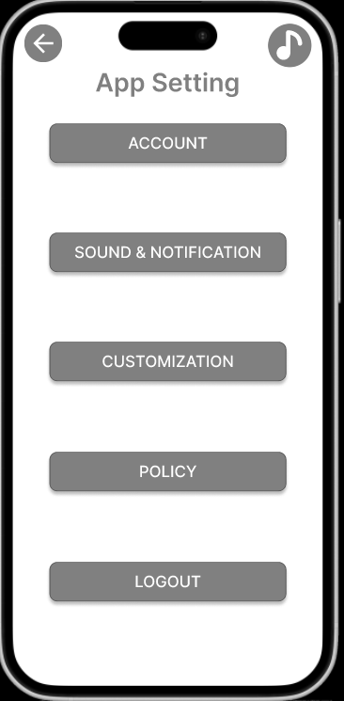
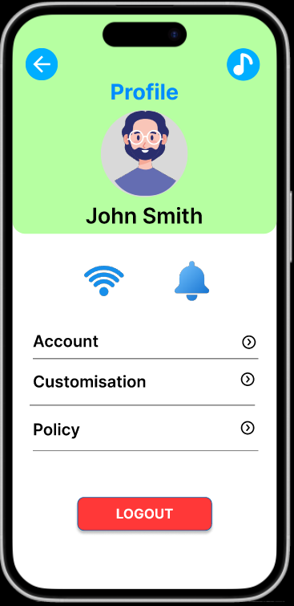
Improvement: Aesthetic and minimalist design
Enhanced Visual Appeal:
Replaced the dull gray layout with vibrant colors, user avatars, and a clean background to make the interface more engaging and modern.
Minimalist Navigation:
Streamlined options with clear icons (e.g., Wi-Fi, notification bell) and concise labels for quicker recognition.
Improved User Profile Integration:
Included a personalized profile section at the top to add a user-centric touch and improve overall hierarchy.
Purpose:
Reduces visual clutter while maintaining a professional and user-friendly look.
Benefit:
Enhances usability by making the design more intuitive and visually appealing, ensuring users can easily find and navigate settings.

Slide 23
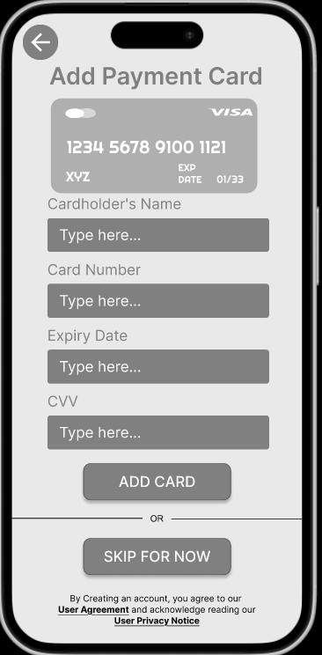
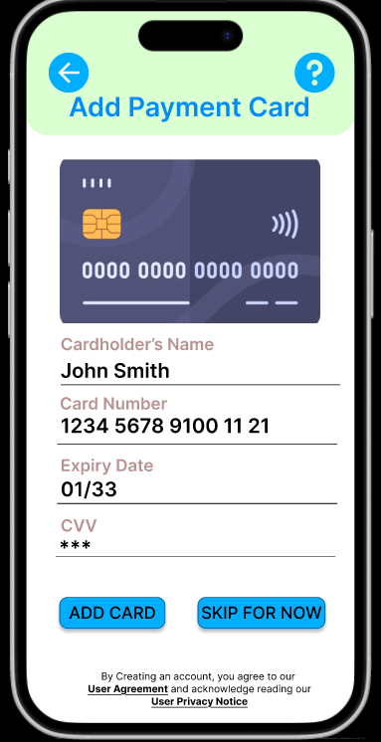
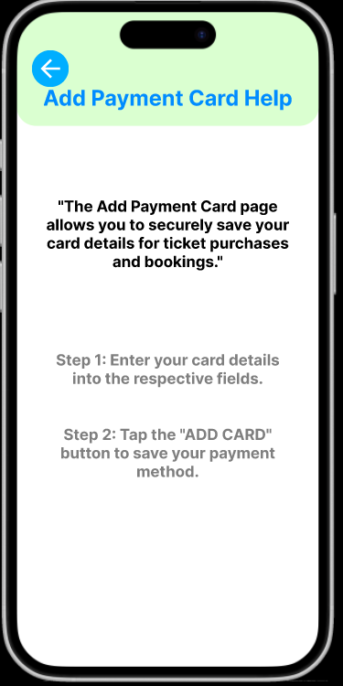
Improvement: Help and documentation

Slide 24
Improvement: Help and Documentation
Added Help Icon:
A question mark (?) icon is included on the "Add Payment Card" page to provide immediate access to guidance.
Purpose:
Allows users to access detailed, step-by-step instructions on how to add a payment card, ensuring clarity and confidence.
Help Page Content:
Overview: Explains the purpose of the page ("Securely save your card details for ticket purchases and bookings").
Step-by-Step Guide:
Enter your card details into the respective fields.
Tap the "ADD CARD" button to save your payment method.
Benefit:
Reduces user frustration by offering accessible, concise help without leaving the current flow, ensuring a smooth user experience.

Slide 25
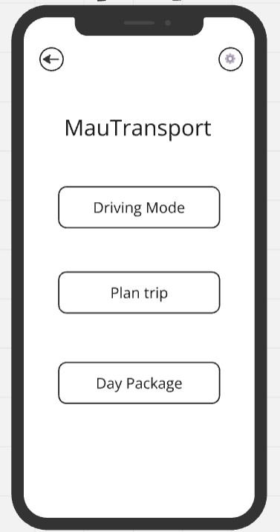
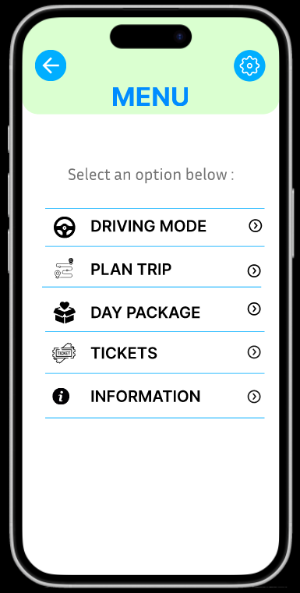
Improvement in low fidelity (Menu Page) after Expert Evaluation
Added "Tickets":
Provides quick access to purchased tickets directly from the main menu.
Enhances convenience for users post-purchase.
Added "Information":
Acts as a user manual to guide navigation through the app.
Ensures first-time users have a seamless experience.
Improved Visual Design:
Clear icons for each menu option.
Organized layout for easy navigation.
Enhanced Accessibility:
Prioritized essential features in the main menu.
Reduced navigation complexity for better usability.

Slide 26
Improvement in low fidelity (Menu Page) after Expert Evaluation
Addition of "Tickets" in the Main Menu:
Purpose: To enhance user convenience by providing quick and easy access to purchased tickets directly from the main menu.
Benefit: Users can view or access their tickets instantly without navigating through multiple submenus, especially after making a purchase.
Addition of "Information" Section:
Purpose: To act as a guide for users, providing them with detailed instructions and a user manual on how to navigate the app.
Benefit: This feature helps first-time users become familiar with the app’s functionalities and ensures a seamless experience by answering common questions.
Improved Layout and Icons:
Clear and recognizable icons are added next to each option, making the menu visually engaging and easier to navigate.
Organized layout ensures that all key features are readily visible without overwhelming the user.
Enhanced Accessibility:
By grouping essential features ("Tickets" and "Information") within the main menu, the app prioritizes user needs and reduces navigation complexity.

Slide 27
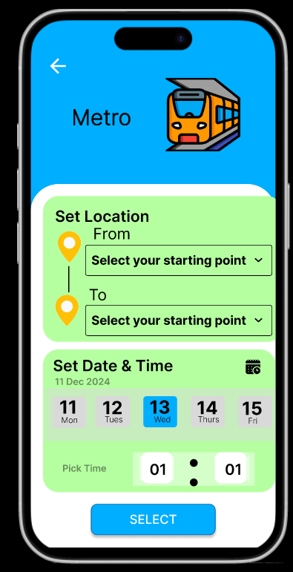
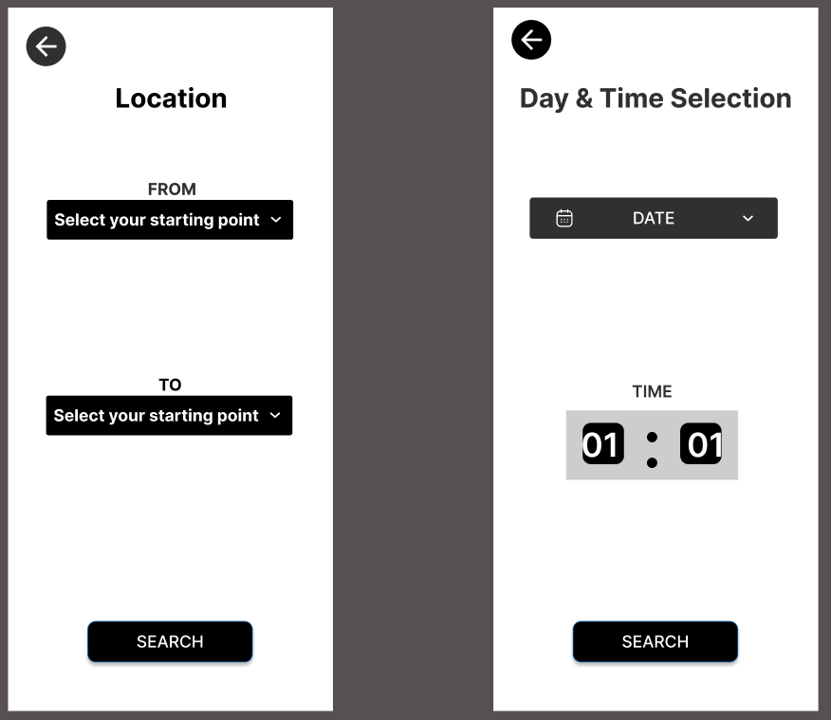
Improvement in low fidelity (plan trip) after Expert Evaluation
We combined location, date, and time selection on a single page to streamline user experience and optimize space efficiently.

Slide 28
Improvement in low fidelity (plan trip) after Expert Evaluation
Combined Location, Date, and Time Selection:
Merged all inputs (From, To, Date, and Time) into a single page.
Purpose: Streamline the user experience by reducing navigation steps.
Benefit: Makes trip planning faster and more intuitive for users.
Improved Space Utilization:
Optimized layout to efficiently display all relevant fields without clutter.
Visual elements (e.g., date picker, time selector) are neatly integrated for better usability.
Enhanced User Interface:
Added clear visual indicators (location icons and date display) for better context.
Bright colors and intuitive design make the page more engaging and user-friendly.
Simplified Navigation:
Users can set their location, date, and time in one step without switching between screens.
A single "Select" button provides clear action for the next step.

Slide 29
Video Prototype
Additional principal in design:
Prototype link
Hierarchy: Establishing visual order of importance.
Alignment: Arranging elements along lines or edges for unity.
Emphasis: Highlighting key elements for attention.
https://www.figma.com/proto/rSZLF0hNNaukclmDQb2dGM/Low-fidelity-1?node-id=470-5739&starting-point-node-id=466%3A1844&t=VvqUWNkc8n9dBCX6-1
White Space: Utilizing empty space for clarity and readability.
Contrast: Creating visual interest with differences in size, color, etc.
Simplicity: Striving for clarity and avoiding unnecessary complexity.
User Experience (UX): Designing for the needs and preferences of the user.
Accessibility: Designing for users with disabilities.

Slide 30
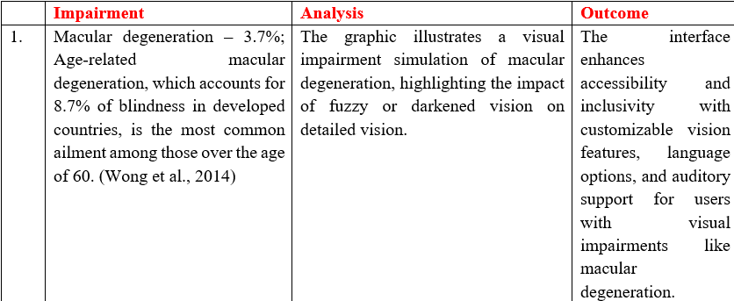
Inclusive design impairment simulator
Macular Degeneration

Slide 31
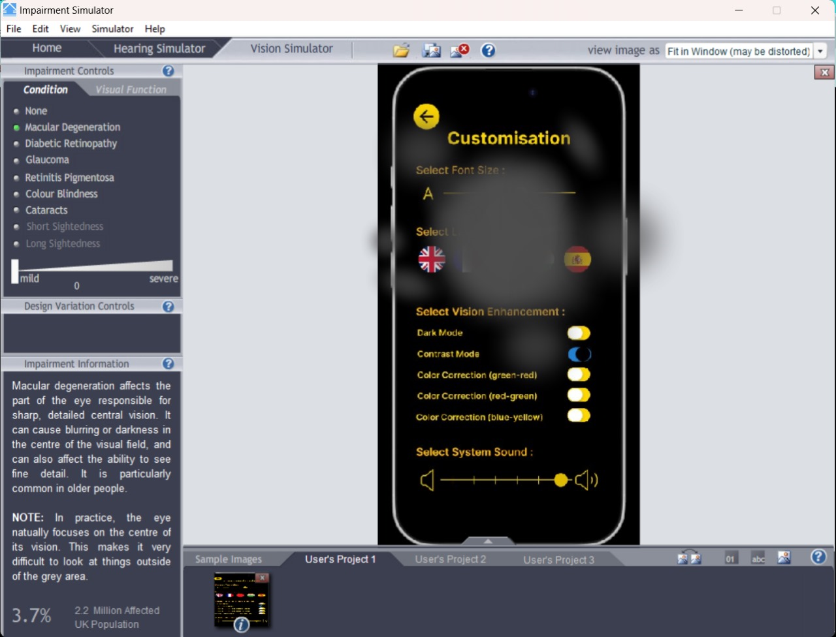
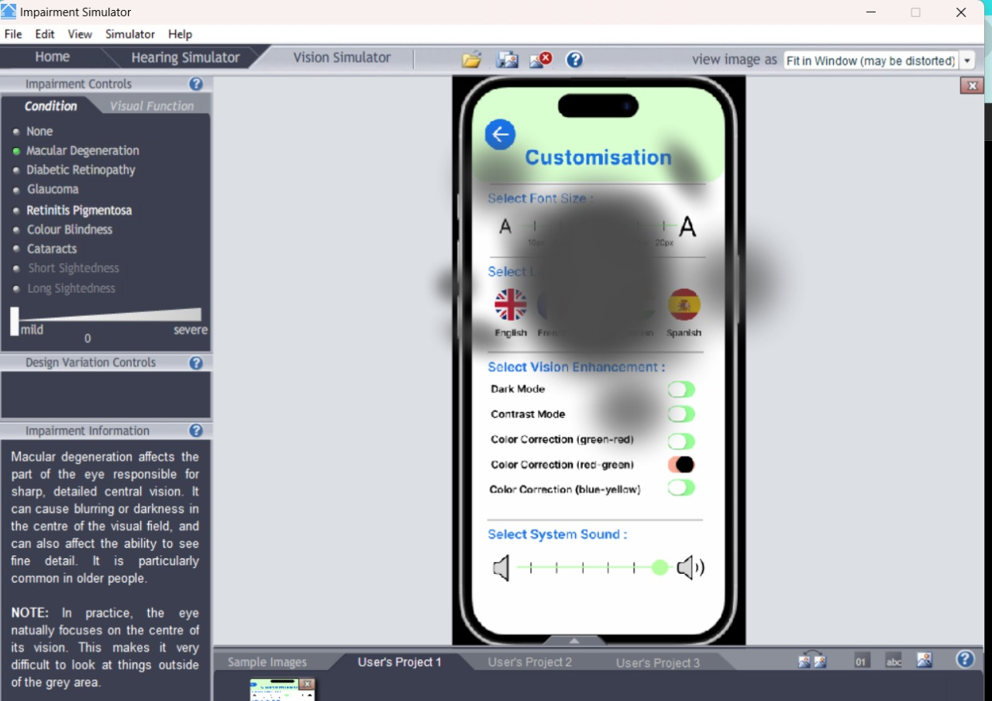
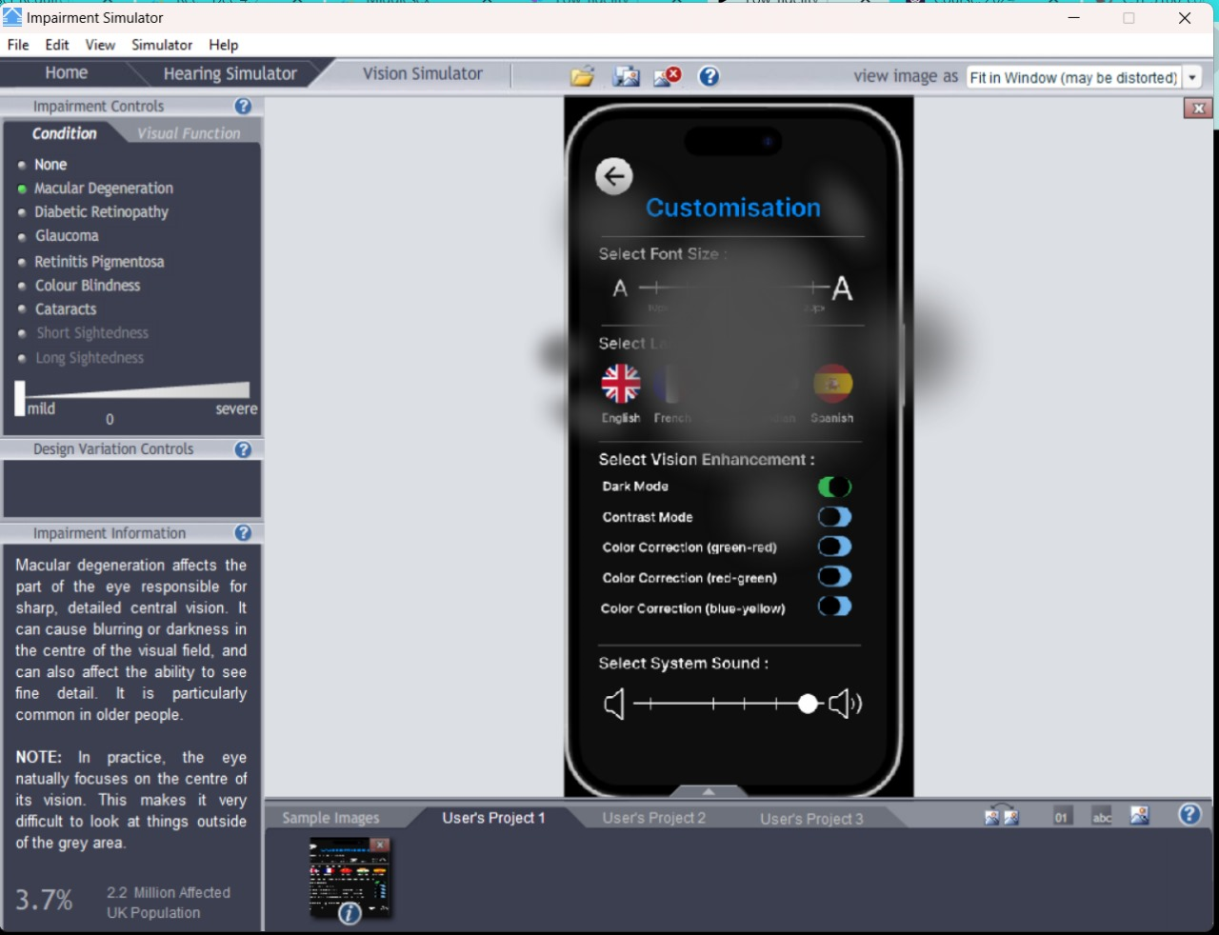
Inclusive design impairment simulator
Macular Degeneration

Slide 32
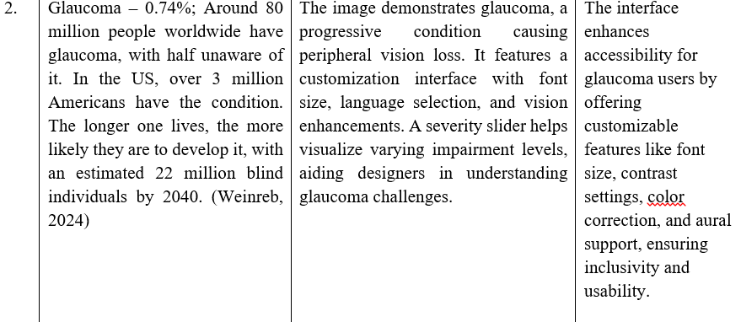
Inclusive design impairment simulator
Glaucoma

Slide 33
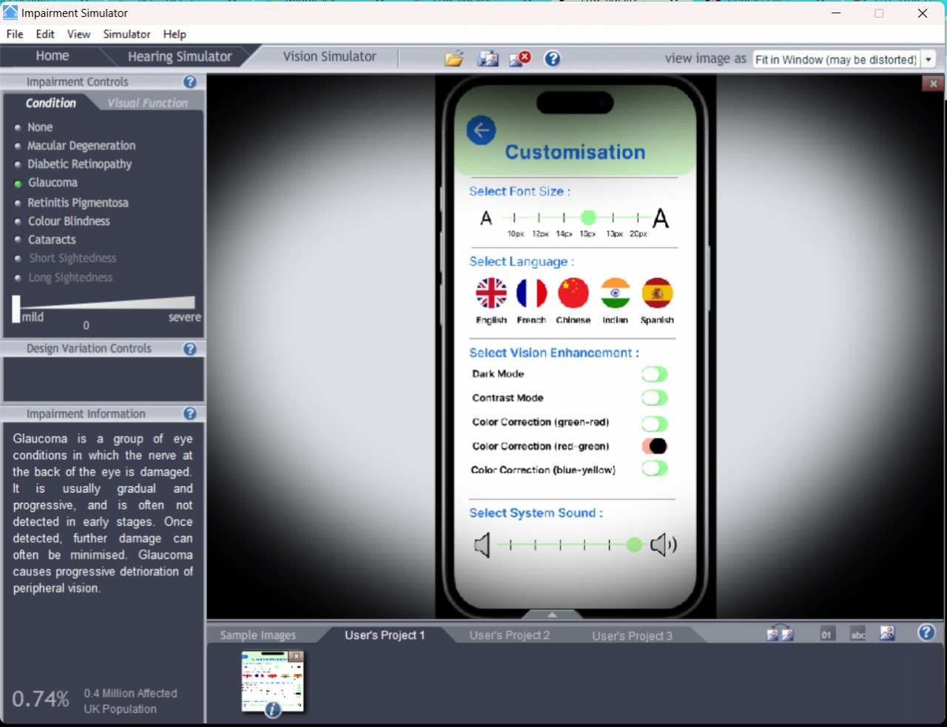
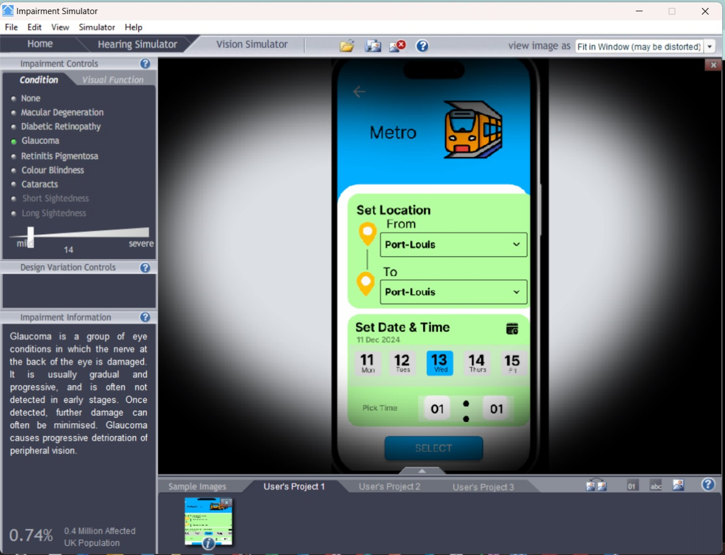
Inclusive design impairment simulator
Glaucoma

Slide 34
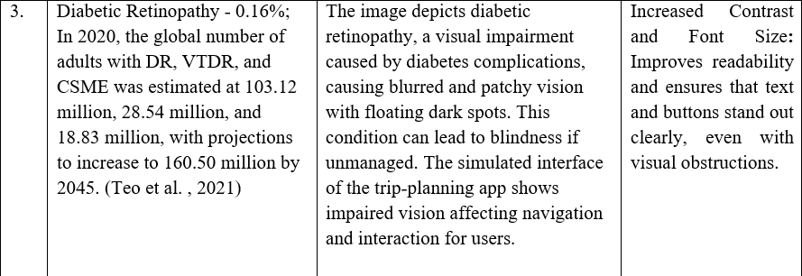
Inclusive design impairment simulator
Diabetic Retinopathy

Slide 35
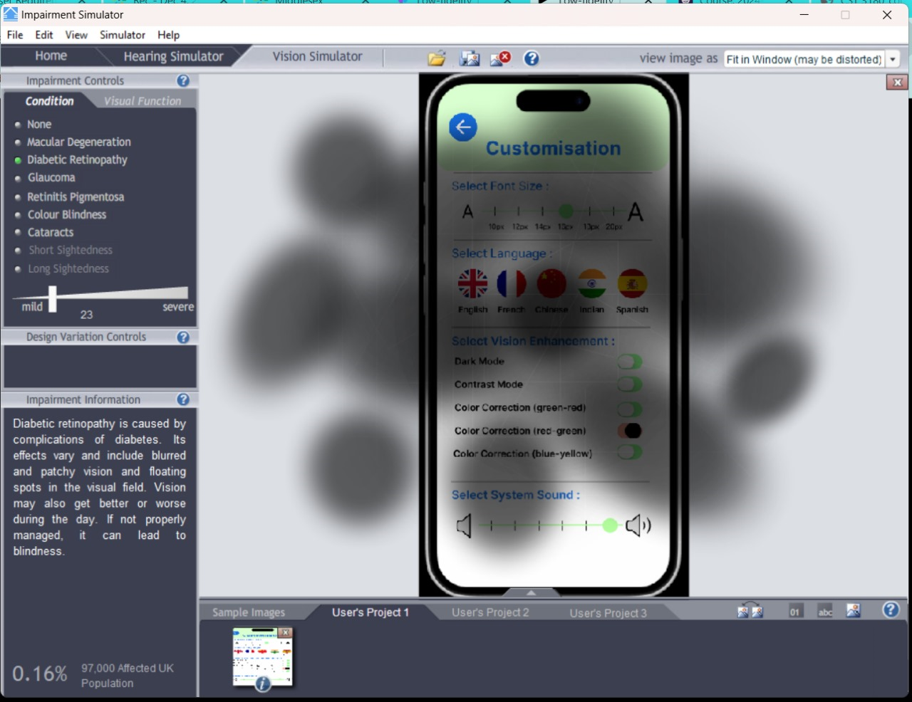
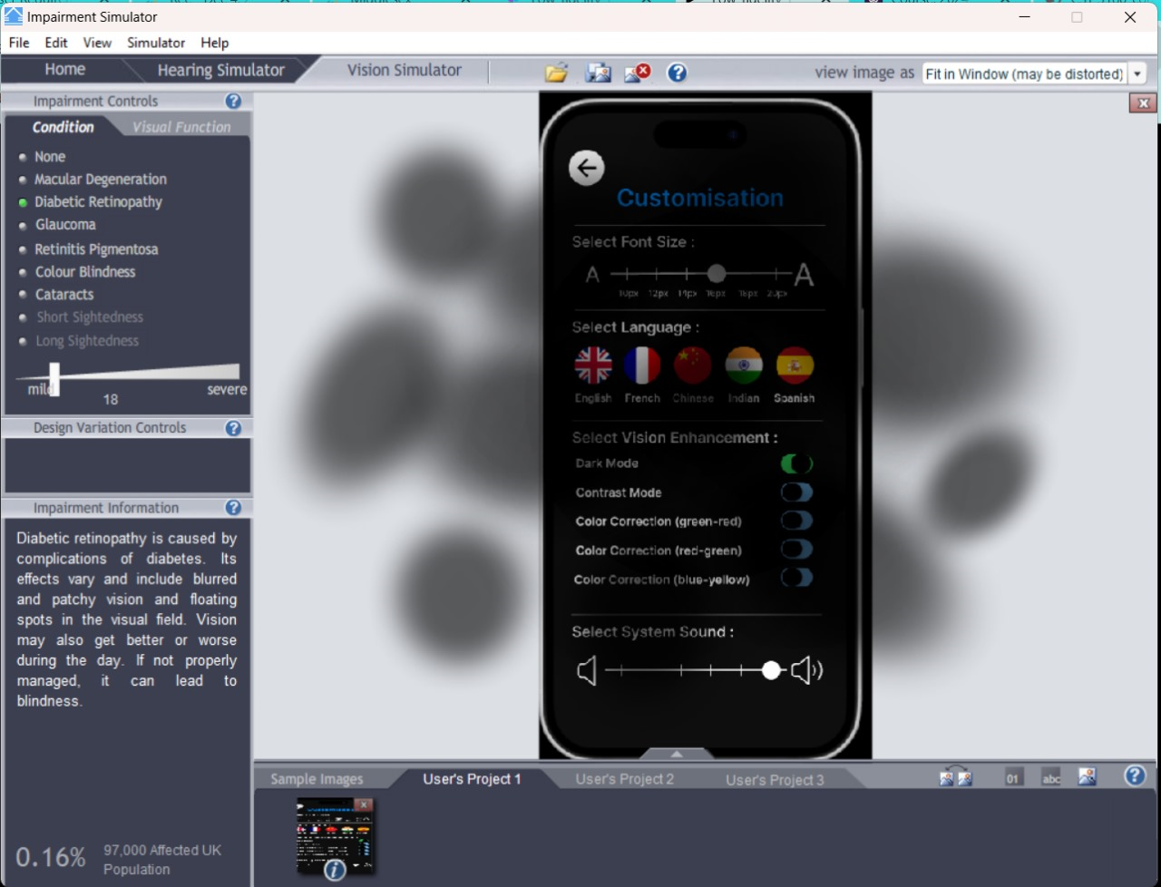
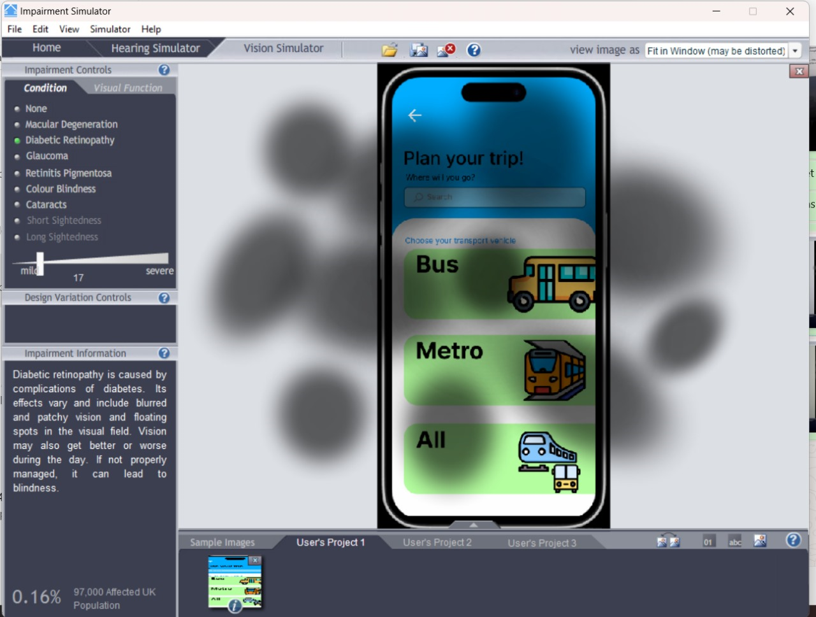
Inclusive design impairment simulator
Diabetic Retinopathy

Slide 36
Inclusive design impairment simulator
Color Blindness
4. | Color Blindness - 5%; Around 2.7 million people in Britain experience colour blindness, a vision deficit where they perceive colours differently from others, often unaware of the issue until a vision test reveals it. (Mandal, 2024) | The simulation demonstrates how color blindness, particularly red-green deficiency, affects visual perception, highlighting the need for high-contrast designs and alternative cues to ensure usability for color-blind users. | The color palette that we choose for the application is adapted to color blind people.

Slide 37
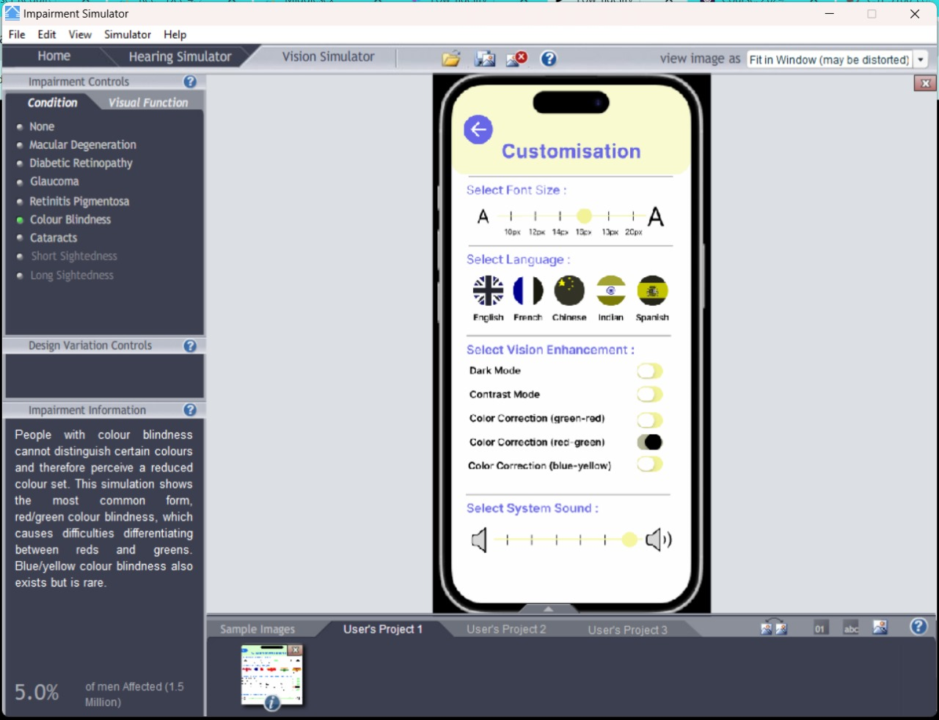
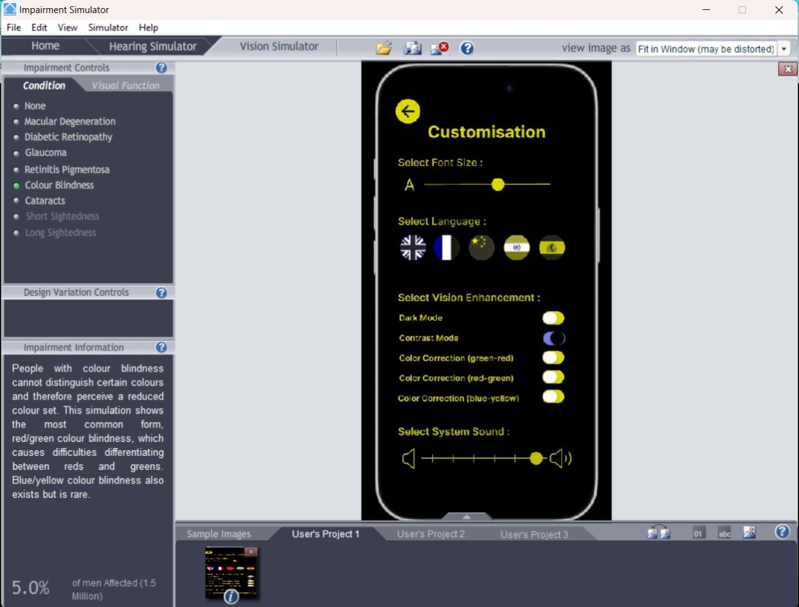
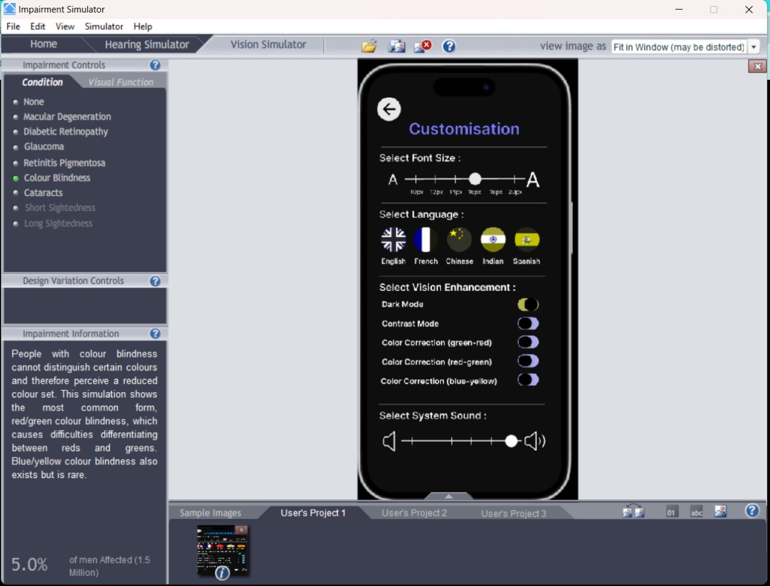
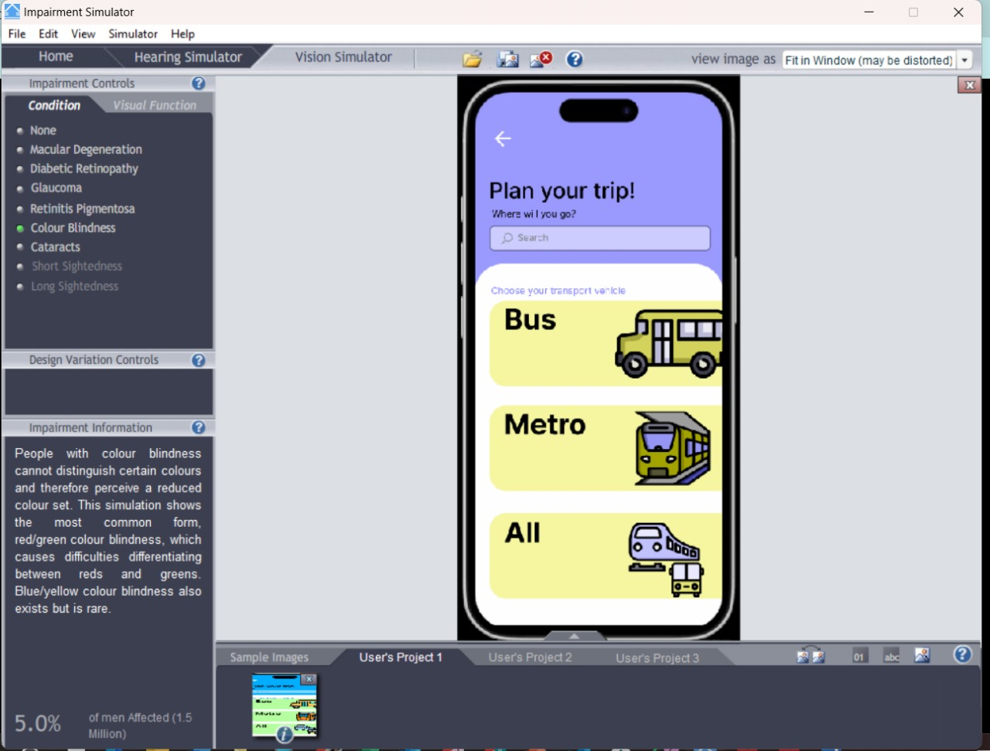
Inclusive design impairment simulator
Color Blindness

Slide 38
Inclusive design impairment simulator
Cataracts
5. | Cataracts - 2%; Around 100 million eyes globally have cataracts causing a visual acuity below 6/60, with 3-4 times more cases for those causing less than 6/18. (Sherwin, 2006) | The simulation demonstrates how cataracts cause blurred vision and faded colours, emphasizing the need for high-contrast designs, larger fonts, and reduced glare to improve accessibility for affected users. | People with cataract can still read because large font size in the application.

Slide 39
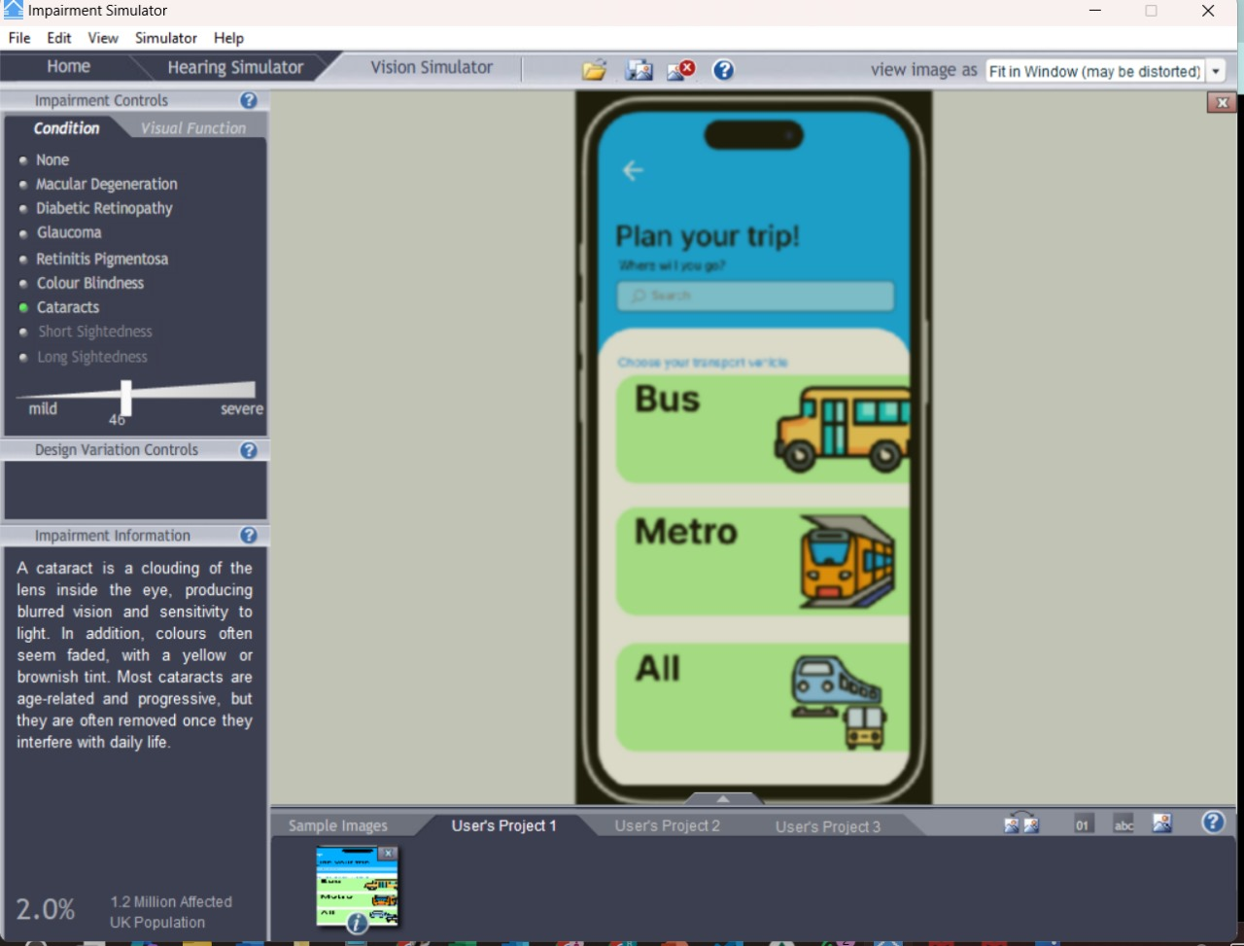
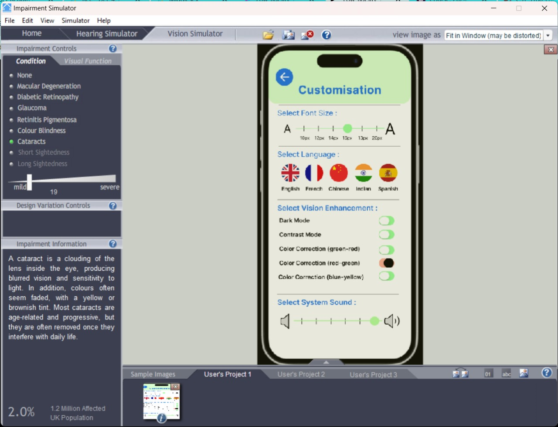
Inclusive design impairment simulator
Cataracts

Slide 40

Inclusive design impairment simulator
Normal, Mild, Moderate - Severe, Severe, and Profound
6. | Normal, Mild, Moderate - Severe, Severe, and Profound - Hearing loss, a partial or complete hearing loss, can be caused by congenital defects, injury, illness, loud noise exposure, or age-related wear, affecting 15% of the American adult population over 18 years, or over 37 million. (Houston.2022) | The interface should prioritize visual and accessibility for users with moderate to severe hearing impairments. Adding visual alerts and sound adjustments could improve the user experience. The clear, structured layout with adjustable font sizes and accessible design supports visual interaction. Vibration feedback and accessibility tips could further enhance inclusivity. | People can increase and decrease the sound range in the application settings.

Slide 41


User Testing Themes

Slide 42


User Testing Themes

Slide 43
Analysis of user testing

Slide 44

SUS
https://drive.google.com/file/d/1KK-ryPsDw05tf8PEv8PWPhhRU7QdgBvJ/view?usp=sharing

Slide 45


SUS
https://drive.google.com/file/d/1KK-ryPsDw05tf8PEv8PWPhhRU7QdgBvJ/view?usp=sharing

Slide 46

SUS
https://drive.google.com/file/d/1KK-ryPsDw05tf8PEv8PWPhhRU7QdgBvJ/view?usp=sharing

Slide 47

SUS
https://drive.google.com/file/d/1KK-ryPsDw05tf8PEv8PWPhhRU7QdgBvJ/view?usp=sharing

Slide 48
Thank you

Slide 49
References
Glaucoma Research Foundation, 2024. Glaucoma worldwide: a growing concern. Glaucoma Research Foundation. Available at: https://glaucoma.org/articles/glaucoma-worldwide-a-growing-concern [Accessed 9 Dec. 2024].
Houston ENT & Allergy. (2022) Hearing loss explained: Normal, mild, moderate, severe, and profound. [Online] Available at: https://www.houstonent.com/blog/hearing-loss-explained-normal-mild-moderate-severe-and-profound [Accessed 10 December 2024].
News-Medical, 2024. Color blindness prevalence. News-Medical.net. Available at: https://www.news-medical.net/health/Color-Blindness-Prevalence.aspx [Accessed 9 Dec. 2024].
Sherwin, J.C., Hewitt, A.W., Coroneo, M.T., Kearns, L.S., and Griffiths, L.R., 2006. The association between ultraviolet radiation exposure and cataract development. Public Health, [online] 120(12), pp.1133-1138. Available at: https://pmc.ncbi.nlm.nih.gov/articles/PMC1705965/ [Accessed 9 Dec. 2024].
Waisbourd, M., Eghrari, A.O., and Smith, R.J., 2021. Advances in glaucoma management and treatment. PubMed, [online] Available at: https://pubmed.ncbi.nlm.nih.gov/33940045/ [Accessed 9 Dec. 2024].
Wong, W.L., Su, X., Li, X., Cheung, C.M.G., Klein, R., Cheng, C.Y., and Wong, T.Y., 2014. Global prevalence of age-related macular degeneration and disease burden projection for 2020 and 2040: a systematic review and meta-analysis. The Lancet Global Health, [online] 2(2), pp.e106–e116. Available at: https://www.thelancet.com/journals/langlo/article/PIIS2214-109X(13)70145-1/fulltext [Accessed 9 Dec. 2024].
Interaction Design Foundation. (n.d.) Skeuomorphism. [Online] Available at: https://www.interaction-design.org/literature/topics/skeuomorphism [Accessed 10 December 2024].

Slide 50
Venngage. (2022). 13 Design Principles — A Complete Breakdown. [online] Available at: https://venngage.com/blog/design-principles/.
‌
Sebastian, T. (2022). Principles of Design | 12 Design Principles. [online] Fix Creative Agency. Available at: https://fixcreativeagency.com/principles-of-design/ [Accessed 10 Dec. 2024].
‌
Appendices
PIS - https://drive.google.com/file/d/1o7fAsL77cnnS-ChiYcdWoVQHyBm7nfyb/view?usp=sharing
Demographic form - https://forms.office.com/e/CHppcaz1Z1
SUS form - https://forms.office.com/e/0VE5MmU06x
Figma prototype - https://www.figma.com/proto/rSZLF0hNNaukclmDQb2dGM/Low-fidelity-1?node-id=466-1844&node-type=frame&t=7pomLbXTmKy9pULh-1&scaling=scale-down&content-scaling=fixed&page-id=466%3A1018&starting-point-node-id=466%3A1844

Slide 51



Slide 52

Transcript

Slide 53


Transcript

Slide 54

Transcript

Slide 55

Transcript

Slide 56

Transcript

Slide 57


Transcript

Slide 58

Transcript

Slide 59

Transcript

Slide 60


Transcript

